Slide 1
Coronavirus Preparedness Checklist
Centers for Disease Control and Prevention Tool for Developing a Comprehensive COVID-19 Response Plan
Notes:
The Coronavirus is currently affecting 178 countries around the world and this number is changing rapidly. The elderly and persons with compromised immune systems are at the most risk of severe illness or death if infected with the Coronavirus. CMS major focus is Infection Control Prevention. Each facility should develop a COVID-19 response plan for a self-assessment of the strength's and weaknesses of current preparedness efforts.

Slide 2
Session Objectives
Utilize the Centers for Disease Control and Prevention Tool for Developing a Comprehensive COVID-19 Response Plan
Identify the elements of a COVID-19 plan and the relationship of the plan to the emergency preparedness plan
Take steps to assess and improve facility preparedness for responding to COVID-19
Identify a facility COVID-19 communication plan
Manage residents infected with COVID-19
Notes:
Our presenter today for this course is Michelle Harubin, a registered nurse who has been Med-Net Compliance since 2016. Michelle’s role at Med-Net is to provide compliance education on various topics dealing with fraud, privacy and data management. All of Med-Net’s compliance education programs are designed to communicate standards and procedures in a meaningful and effective manner.

Slide 3

Taking Steps to Assess and Improve Preparedness for Responding to COVID-19
Centers for Disease Control and Prevention (CDC) asks that nursing homes and other long-term care facilities take steps now to assess and improve their preparedness for responding to coronavirus 2019 (COVID-19).

Slide 4
Taking Steps to Assess and Improve Preparedness for Responding to COVID-19 (2)
The CDC checklist should be used as one tool to develop a comprehensive COVID-19 response plan, including plans for:
Rapid identification and management of ill residents
Consideration for visitors and consultant staff
Supplies and resources
Sick leave policies and other occupational health considerations
Education and training
Surge capacity for staffing, equipment, supplies, and postmortem care
Notes:
The checklist identifies key areas that long-term care facilities should consider in their COVID-19 planning. This tool can be used to self-assess the strengths and weaknesses of current preparedness efforts. The checklist is not mandatory but rather it highlights important areas to review to prepare for the possibility of residents with COVID-19.

Slide 5
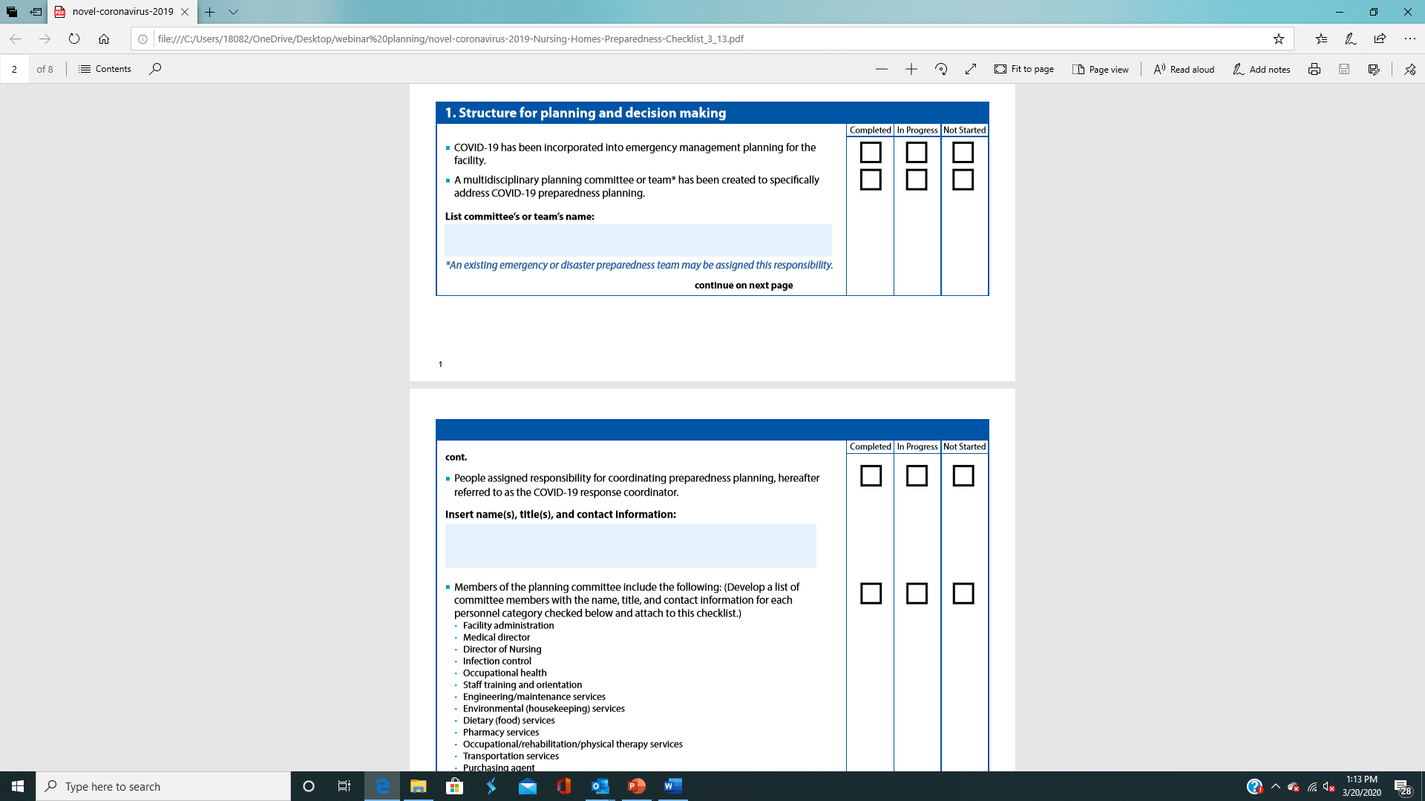
Using the Checklist
All action items on the CDC checklist are meant to be checked as:
Completed
In Progress
Not Started
It is strongly recommended that for all action items that are listed as In Progress or Not Started that the person responsible for completing the item, as well as the target date for completion, also be listed.

Slide 6
Meeting the Needs of Each Facility
The CDC checklist should be adapted for each facility to meet their needs and circumstances based on differences among facilities.
Resident characteristics
Facility size
Scope of Services
Hospital affiliation

Slide 7
Organization of the CDC Checklist
The CDC’s checklist is divided into 3 main categories with sub-categories :
Structure for planning and decision making
Development of a written COVID-19 plan
Elements of a COVID-19 plan
General
Facility Communications
Supplies and Resources
Identification and Management of Ill Residents
Considerations about Visitors
Occupational Health
Education and Training
Surge Capacity
Postmortem Care

Slide 8
Structure for Planning and Decision Making
The facility’s COVID-19 preparedness plan should be incorporated into the facility’s infection prevention and control and emergency management plans.
A multidisciplinary emergency planning committee or team should specifically address COVID-19 preparedness.
A COVID-19 response coordinator should be designated to ensure implementation of the plan and evaluation of effectiveness.
Committee members’ names, titles, and contact information should be documented as part of the checklist.
Notes:
Members of the planning committee should include the administrator, medical director, director of nursing, infection control, infection control, occupational health, staff trainer. Maintenance services, environmental services, dietary, pharmacy services, rehab services, transportation services, purchasing, facility staff representative, and other members as appropriate (clergy, resident and family representative, quality improvement, etc)

Slide 9
Development of a written COVID-19 Plan
The COVID-19 preparedness plan should be readily available at the facility and accessible by staff.
The plan should identify who is authorized to implement the plan.
Review federal, state, regional, and local plans for COVID-19 or pandemic influenza relevant sections for incorporation into the facility’s COVID-19 plan.

Slide 10
Elements of a COVID-19 Plan
The purpose of the COVID-19 Plan is to protect the residents, healthcare personnel, and visitors from respiratory infections including COVID-19.
The plan should state who is responsible for:
  Monitoring public health advisories (federal and state)
  Updating the COVID-19 response coordinator and members of the COVID-19 planning committee when COVID-19 is in the geographic area
The plan should have a process for inter-facility transfers that includes notifying transport personnel and receiving facilities about a resident’s suspected or confirmed diagnosis prior to transfer.

Slide 11
Elements of a COVID-19 Plan
The plan should have a system in place to monitor and internally review the development of COVID-19 amongst residents and healthcare personnel (HCP) within the facility.
Information from the monitoring system is used to implement prevention interventions.
Infection Control policies that outline the recommended Transmission-Based Precautions that should be used when caring for residents with respiratory infections should be incorporated into the COVID-19 plan.
The facility should periodically review specific Infection Prevention Controls guidance for healthcare facilities caring for residents with suspected or confirmed COVID-19.
Notes:
Interventions may include Cohorting and isolation.
For undiagnosed respiratory infection, standard, contact and droplet precautions with eye protection are recommended unless the suspected diagnosis requires airborne precautions (i.e. tuberculosis)

Slide 12
COVID-19 Preparedness Planning:
Facility Communication
Plan
Key public health points of contact during a COVID-19 outbreak should be identified in your plan.
A person within the facility or corporation should be assigned the responsibility for communications with public health authorities during a COVID-19 outbreak.
A person within the facility should be assigned to communicate with staff, residents, and their families regarding the status and impact of COVID-19 in the facility.
A process should be in place to have up-to-date contact information for family members or guardians.
Notes:
Key public health points of contact should include local, state and state’s long-term care professional/trade association and any healthcare coalitions. The point of contact and their contact information should be readily available.

Slide 13
Facility Communication
Communication plans include how signs, phone trees, and other methods of communication will be used to inform staff, family members, visitors, and other persons coming into the facility about the status of COVID-19 within the facility.
A list of other healthcare entities and their points of contacts with whom it may be necessary to maintain communication during an outbreak should be incorporated into the COVID-19 preparedness plan.
Notes:
Other healthcare entities that would be important for contact during information for a COVID-19 outbreak may include other long-term care facilities in the area, local hospitals, and relevant community organizations.

Slide 14
COVID-19 Preparedness Planning: Supplies and Resources
The facility should have a list of supplies that would be necessary during a COVID-19 outbreak.
  Alcohol-based hand sanitizer
  Soap and paper towels
  Signage for posting outside of resident rooms indicating appropriate PPE
  Tissues
  Facemasks
  Respirators
  Trash disposal bins
  EPA-registered hospital grade disinfectants
The facility should have a process in place for monitoring supply levels and a contingency plan that includes communicating with their health department and healthcare coalition when they experience (or anticipate experiencing) supply shortages.
Notes:
The contact information for the healthcare coalition should be available with the preparedness plan.

Slide 15
COVID-19 Preparedness Planning: Identification and Management of Ill Residents
Identify a process to manage residents with symptoms of respiratory infection upon admission and daily during their stay.
Define criteria and protocol for initiating active surveillance for respiratory infection among residents and healthcare personnel.
State the process for notification of the health department for clusters of respiratory infections, severe respiratory infections, or suspected COVID-19 cases.
Develop criteria and a protocol for limiting symptomatic and exposed residents to their rooms, halting group activities, communal dining, closing units or entire facility to new admissions, cohorting residents with symptoms of respiratory infection, and dedicating HCP to work only on affected units.

Slide 16
COVID-19 Preparedness Planning:
Considerations for Visitors
The COVID-19 preparedness plan should identify and develop signs that may be posted at the entrance of the facility instructing visitors not to visit if they have fever or symptoms of a respiratory infection and when visitors will be limited or restricted from the facility. The policy should also address when visitor restriction will be lifted.
If a visitor restriction is implemented, the facility should have a process that supports remote communication between the resident and visitor.

Slide 17
COVID-19 Preparedness Planning: Occupational Health
Sick leave policies should be non-punitive and flexible and consistent with public health policies that allow ill staff to stay at home.
The facility should instruct staff to regularly monitor themselves for fever and symptoms of respiratory infection as part of their routine practice.
A process should be in place to actively screen staff for fever and symptoms when they report to work, and how to identify and manage staff with fever and symptoms of respiratory infection.
A plan should be in place for monitoring and assigning work restrictions for ill and exposed staff, and providing respiratory protection that includes medical evaluation, training, and fit testing.

Slide 18
COVID-19 Preparedness Planning:
Education and Training
Designate someone within the facility for coordinating education and training.
Provide education and training to staff, residents, and family members to help them understand the implications of, and basic prevention and control measures for, COVID-19.
Identify language and reading-level appropriate materials to supplement and support education and training programs to staff, residents, and their families.
Ensure there is a plan to obtain these materials.
Notes:
The reading-level appropriate and language materials may be obtained through state and federal public health agencies and professional organizations.

Slide 19
COVID-19 Preparedness Planning:
Education and Training (2)
Education and job-specific training of staff should include information on recommended infection control measures to prevent spread of COVID-19 including:
Signs and symptoms of respiratory illness, including COVID-19.
Monitoring residents for signs and symptoms of respiratory illness.
Keeping residents, visitors, and staff safe by using correct infection control practices, including proper hand hygiene and selection and use of PPE. Training should include return demonstrations to document competency.
Staying home when ill.
Implementing sick leave policies and recommended actions for unprotected exposures (e.g., not using recommended PPE, an unrecognized infectious patient contact).

Slide 20
COVID-19 Preparedness Planning: Education and Training (3)
A facility should have a plan for expediting the credentialing and training of non-facility staff brought in from other locations to provide resident care if a facility reaches a staffing crisis.
  Implement a facility orientation checklist for all non-facility staff

Slide 21
COVID-19 Preparedness Planning: Surge Capacity
Assign a person within the facility to conduct the daily assessment of staffing status and needs during a COVID-19 outbreak.
Develop a staffing contingency plan that identifies the minimum staffing needs and prioritizes critical and non-essential services based on a resident’s health status, functional limitations, disabilities, and essential facility operations.
Consult legal counsel and state health department contacts to determine the applicability of declaring a facility “staffing crisis” and appropriate emergency staffing alternatives, consistent with state law.
Collaborate with local and regional planning and response groups to address widespread healthcare staffing shortages during a crisis.

Slide 22
COVID-19 Preparedness Planning: Surge Capacity (2)
Consumables and durable medical equipment and supplies:
Estimate the quantities of essential resident care materials, equipment, and PPE that would be needed during an eight-week outbreak.
  Estimates should be shared with local, regional, and tribal planning groups to plan stockpiling agreements.
Address likely supply shortages, including strategies for using normal and alternative channels for procuring needed resources.
  Develop a strategy for how priorities would be made in the event there is a need to allocate limited resident care equipment, medications, and other resources.
  Track and report available quantities of consumable medical supplies, including PPE.
Notes:
Equipment may include IV pumps and medications.

Slide 23
COVID-19 Preparedness Planning:
Postmortem Care
Develop a contingency plan for managing an increased need for postmortem care and disposition of deceased residents.
Identify an area in the facility to be designated as a temporary morgue.
Discuss with local and regional planning contacts for local plans to expand morgue capacity.

Slide 24
Resources
The checklist can be accessed at:
https://www.cdc.gov/coronavirus/2019-ncov/downloads/novel-coronavirus-2019-Nursing-Homes-Preparedness-Checklist_3_13.pdf
Additional Resources available on Med-Net Academy.
  Emergency Preparedness Checklist
  Infection Prevention and Control Plan
These resources can be accessed at:
https://www.mednetcompliance.com/med-net-academy/condensed-cms-policies/

Slide 25
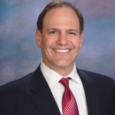

Expert Panelist for Question & Answers
David S. Barmak J.D., Chief Executive Officer
Susan E. Harris, CRA, ADC, LNHA, BA, MC
Notes:
We are pleased to present..Our Expert Panelist for today:
David S. Barmak
Has been the Chief Executive Officer Of Med-Net Concepts since 1997
He received a JD from Cornell University and has lectured and written extensively in the areas of corporate compliance, risk management and operational legal affairs.
Susan E. Harris
Is a licensed nursing home administrator with over 30 years experience and has been with Med-Net Concepts since 2018. She is knowledgeable in all aspects of skilled nursing facility operations including regulatory, HIPAA, ethics and compliance, QAPI/Performance and outcome evaluation

Slide 26

Questions

Slide 27

196 Princeton Hightstown Rd.
BLDG 1A, STE 1A
West Windsor, NJ 08550
P: (609) 454-5020
F: (609) 454-5021
www.mednetcompliance.com

